Slide 1
August 2, 2021 Work Group Update

Slide 2
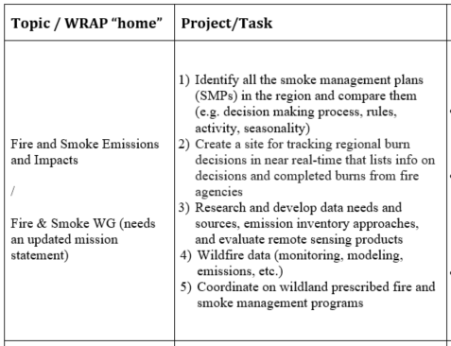
Fire & Smoke Work Group Progress Update 12/1/2020 Board Approved Work Topics
July 2021
1), 2) → SMP Mapping Tool Team:
On hold for a month of two until RH SIP work done
3) → Exceptional Events Support Team:
Updating EE Data Resources List - update approved and posted
First meeting was July 8, next is Sept 15
4) → Conceptual Model for Fire Data:
Planning stakeholder workshops - delayed until October
5) → Wildland/Rx Fire Nexus Team: Set to simmer until RH SIPs are done.
5) → On July 26 call, Kris Ray presented “Navigating Wildfire Smoke Issues in Tribal Communities”. Slides and recording posted to website.
Next call – Monday September 13.

Slide 3
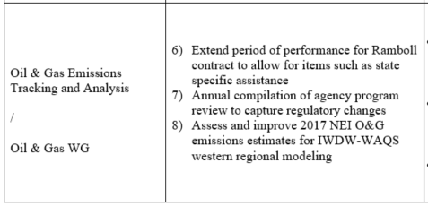
Oil & Gas Work Group Progress Update 12/1/2020 Board Approved Work Topics
July 19th,2021 - Limited state-only meetings with inventory staff to discuss oil and gas inventories, and needs. Debrief with FLMs and EPA on Aug 3rd and get additional input from the entire work group.
July 28th -Co-chairs Amanda Brimmer (EPA R8) and Mark Jones (NMED AQB) met with Tom Moore (WRAP) to begin process of redefining/updating work group scope and work plan tasks.
August 3rd -2:00 p.m. – 3:30 - p.m. (note new time) full OGWG call
See final agenda: https://www.wrapair2.org/pdf/OGWG%20Aug3_2021%20agenda_final.pdf
Next steps on OGWG scope reboot (document to be completed in October 2021).
Debrief and review feedback received from July 19th states’ meeting.
Review continuing changes and improvements to EIs and topics in the sector.
Review work by federal agencies on NEPA planning and EIs for tribal lands.
Review Ramboll memo comparing WRAP OGWG activity/emissions projections methods to EIA-based O&G activity projections in preparation for August 12th and Sept. 9th NOGEC meetings.
Roundtable state, FLMs and tribes on continuing to track O&G Sector.

Slide 4
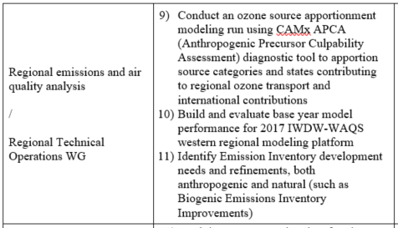
RTO Work Group Progress Update 12/1/2020 Board Approved Work Topics
July 2021
Held meeting July 21st with OAQPS Regional Haze lead and EPA modelers to review WRAP modeling research scenarios
US Anthro Rate of Progress/Dynamic Evaluation work
Future Fire scenarios
Releasing Ramboll reports for RTOWG and IWDW-WAQS Cooperator review during August
2017 WRF modeling
2017 GEOS-Chem boundary conditions
Data will be available for download from IWDW
No funding to complete rest of 2017 modeling platform, or to address #9 and #11 in the table
Next RTOWG/IWDW Technical Committee meeting will not occur until late Sept. (at the earliest)

Slide 5
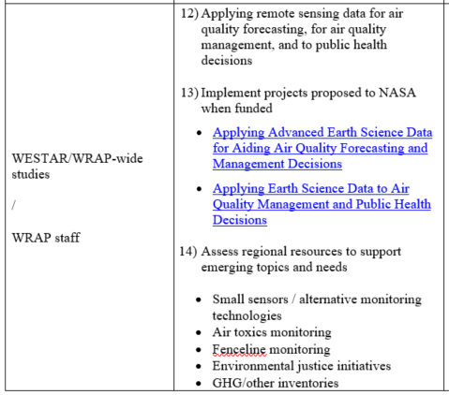
WESTAR/WRAP Progress Update 12/1/2020 Board Approved Work Topics
July 2021
#12-13 – addressed in 2 recent project funding proposals to NASA
NNH21ZDA001N-HAQ:A.37 Earth Science Applications: Health and Air Quality
Proposals submitted June 30th, funding up to $250-$300k/year for 3 years
Wildland Fire Emissions Data Warehouse (WFEDW)
To build / implement FSWG Conceptual Model for Fire Data
WESTAR-WRAP managed, work by Air Sciences (science data design), Michigan Tech Research Institute (emissions tools), and CSU-CIRA (warehouse)
Workshop in Oct. while NASA decides on funding
Organizing Remote Sensing Science Data for a Purpose: Decision Support Systems for Air Quality Management Applications
Address gaps between Earth Science data and routine evaluation and application by air quality management agencies for regulatory analysis and decision-making activities
Co-managed by University of Alabama in Huntsville and WESTAR-WRAP, leveraging inputs from experts at air agencies in the West and WESTAR-WRAP Work groups
#14 – awaiting policy / implementation strategies from Biden EPA
White House has just released the Justice40 draft guidance document describing how federal agencies should begin the process of ensuring that at least 40% of the benefits from federal energy and environmental spending reach disadvantaged communities.
#16 – plan is to have Tom, Pat Brewer, and Jay Baker help states with questions in SIP submittal and EPA review process, no plans for other contracted support
WESTAR will maintain operating agreement with CSU-CIRA for TSS/IWDW

